Slide 1
QuizMaster
Group: NULL Pointers
Parth Patel
Dev Patel
Shailen Sutradhar
Gautam Santhanu Thampy

Slide 2
Team & Roles
Parth Patel
01
Frontend, client‑side backend, Auth, Backend Integration
Dev Patel
02
Cloud deployment, CI/CD
Shailen Sutradhar
03
Requirements, Lambda,
API Integration
Gautam S. Thampy
04
PDF processing Lambda, Prompt Engineering

Slide 3


Studying through theoretical content is boring
Manual quiz creation = slow, error-prone
Need adaptive self-assessment on any material
QuizMaster auto-generates quizzes from user PDFs, grades instantly, stores results and allows to retake for practice
Problem and Solution
Before QuizMaster
After QuizMaster

Slide 4
Who Will Use It? – Intended Audience
Students: study guides & exam prep
Universities: dynamic, cheat-resistant tests
Enterprises: onboarding & training checks
General audience: books / papers → quizzes

Slide 5













Technical Stack
Frontend: React + TypeScript + Vite
Backend: AWS Lambda, API Gateway
Storage: S3 (PDFs) • DynamoDB (quizzes)
LLM: Google Gemini
Auth: Firebase
Cloud Deployment: AWS EC2
CI/CD: GitHub, AWS CodePipeline, AWS CodeDeploy

Slide 6
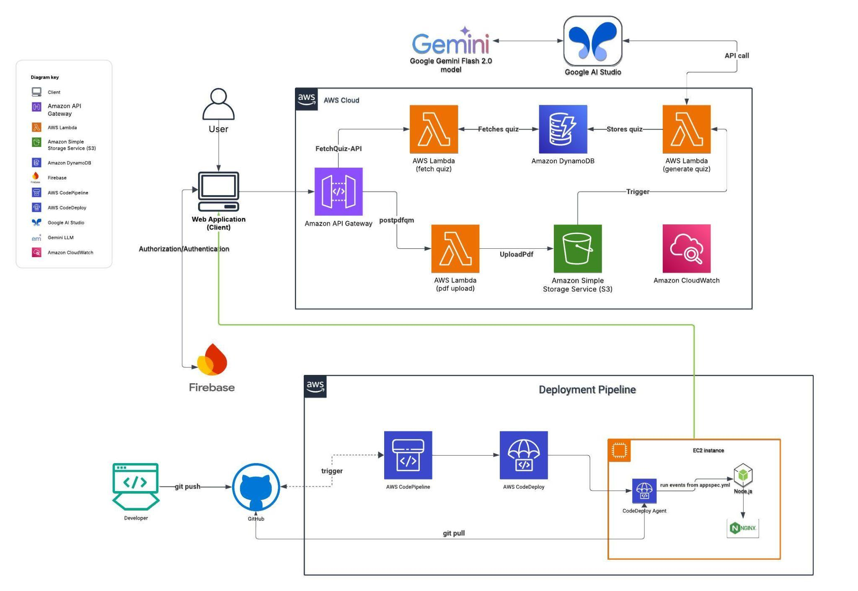
High-Level Architecture

Slide 7
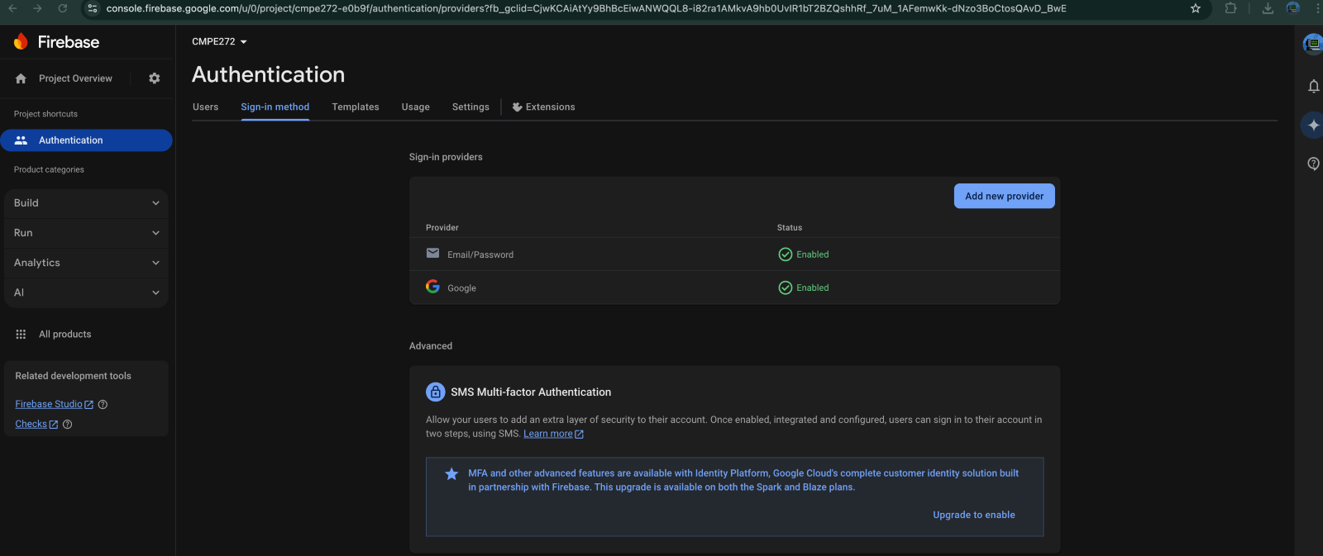
Frontend and Authentication
Developed the application in ReactJS, Vite and Typescript
Firebase Authentication is used to allow users to login via email or Google account.

Slide 8
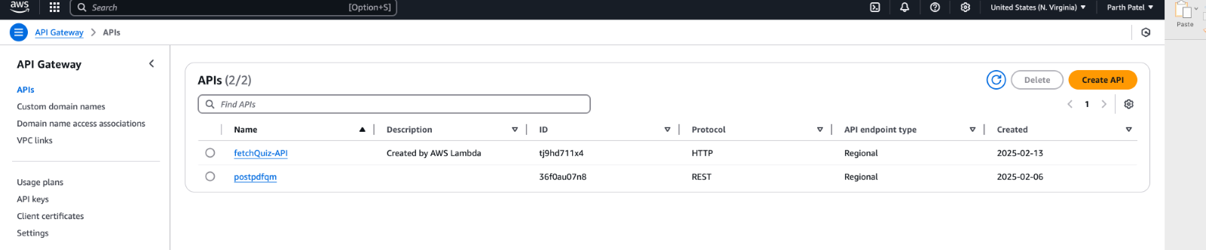
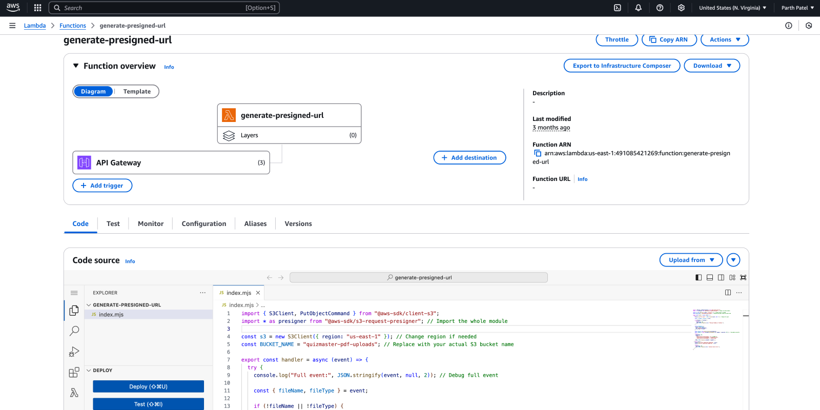
Backend Integration
Two API Gateways have been created:
postpdfqm Gateway (REST Protocol):
Responsible for accepting the quiz name and PDF file, creating a unique destination location in an S3 bucket, and uploading the file.
Only handles POST operations.
fetchQuiz-API Gateway (HTTP Protocol):
Responsible for fetching the quiz from DynamoDB once created.
Also used to fetch quizzes in the "My Quizzes" section.
Only handles GET operations.

Slide 9
AWS Lambda Functions
Generate-presigned-url:
Accepts the quiz name and file via the API Gateway
uploads the file into the S3 bucket.

Slide 10

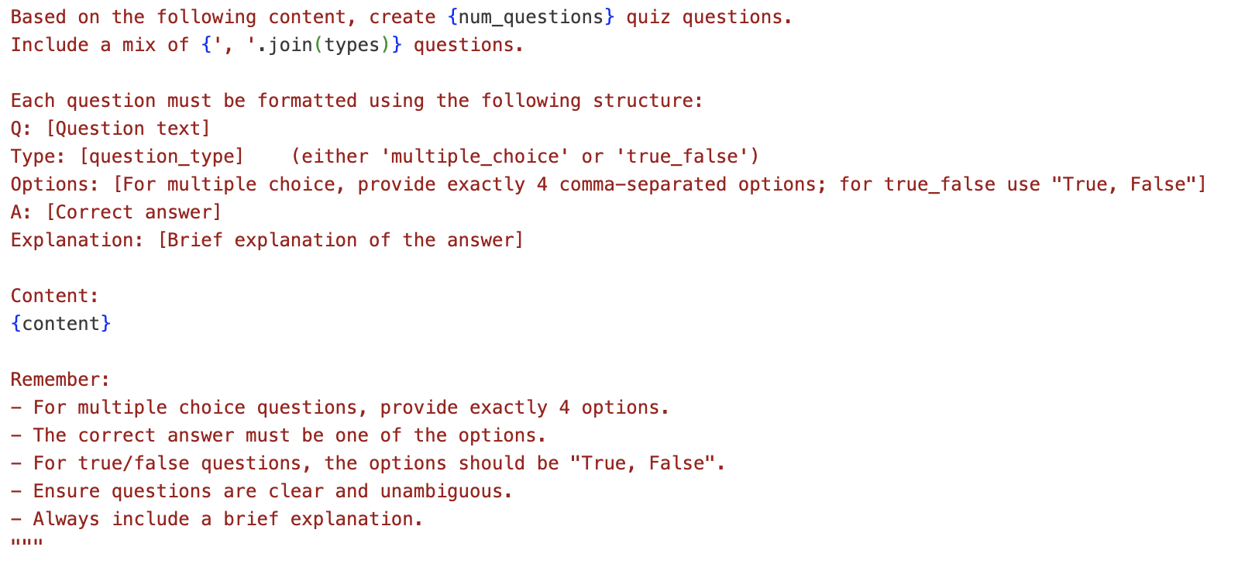
Quiz generation
Prompt Engineering
PDF upload in bucket triggers
Process_pdf_lambda:
Parses the PDF using PyPDF2
Sends it along with a prompt to Gemini
Receives a JSON containing questions and answers.
JSON response is then stored in DynamoDB.
Structured Template
Explicit Constraints
Dynamic Content Injection
Model Configuration Tuned
Reminder Prompts
Notes:
“Let’s dive into our end-to-end quiz-generation pipeline:
PDF Upload → Lambda Trigger A user drops a PDF into the S3 uploads/ bucket. That event immediately fires our process_pdf_lambda.
Presigned URL & Text Extraction (≈15 s) The Lambda generates a presigned URL, fetches the PDF via requests, and extracts every page’s text with PyPDF2—yielding a clean content blob for our model.
Generate Quiz via Gemini (≈15 s) We inject that text into our generate_quiz() function, which builds a structured prompt, calls Gemini through the google.generativeai SDK, and returns raw Q/A output.
Parse, Enrich & Validate (≈15 s) We parse the LLM’s response into JSON question objects, attach metadata—unique IDs, timestamps, user_id, document_name—and guard against malformed output with built-in reminder lines.
Persist to DynamoDB (≈15 s) Finally, store_quiz_in_dynamodb() writes the full quiz payload under a quiz_id. CloudWatch logs every step for full observability.
Prompt Engineering Highlights
Structured Template: Q:, Type:, Options:, A:, Explanation:
Explicit Constraints: exactly four MC options or “True, False”
Model Settings: temperature=1, top_p=0.95, top_k=40, max_output_tokens=8192
Reminder Lines: enforce correct formatting and explanations
All together, this workflow plus our prompt design delivers consistent, high-quality quizzes in under a second.

Slide 11

Why Gemini?
Huge Context Window
Multimodality
Reliability
Flash Variant Cost/Performance
Source: https://tenor.com/view/gemini-gemini-ai-google-google-ai-chat-gpt-gif-17398376242525336213
Notes:
“Alright, let’s start with why we picked Google’s Gemini as our LLM backbone.
Huge Context Window: feed entire chapters at once—no chunking.
Future-Ready Multimodal: text today, diagrams or tables tomorrow.
Continuous Model Updates: automatic safety patches and improvements. Flash-Variant Performance: sub-second replies at predictable cost.

Slide 12
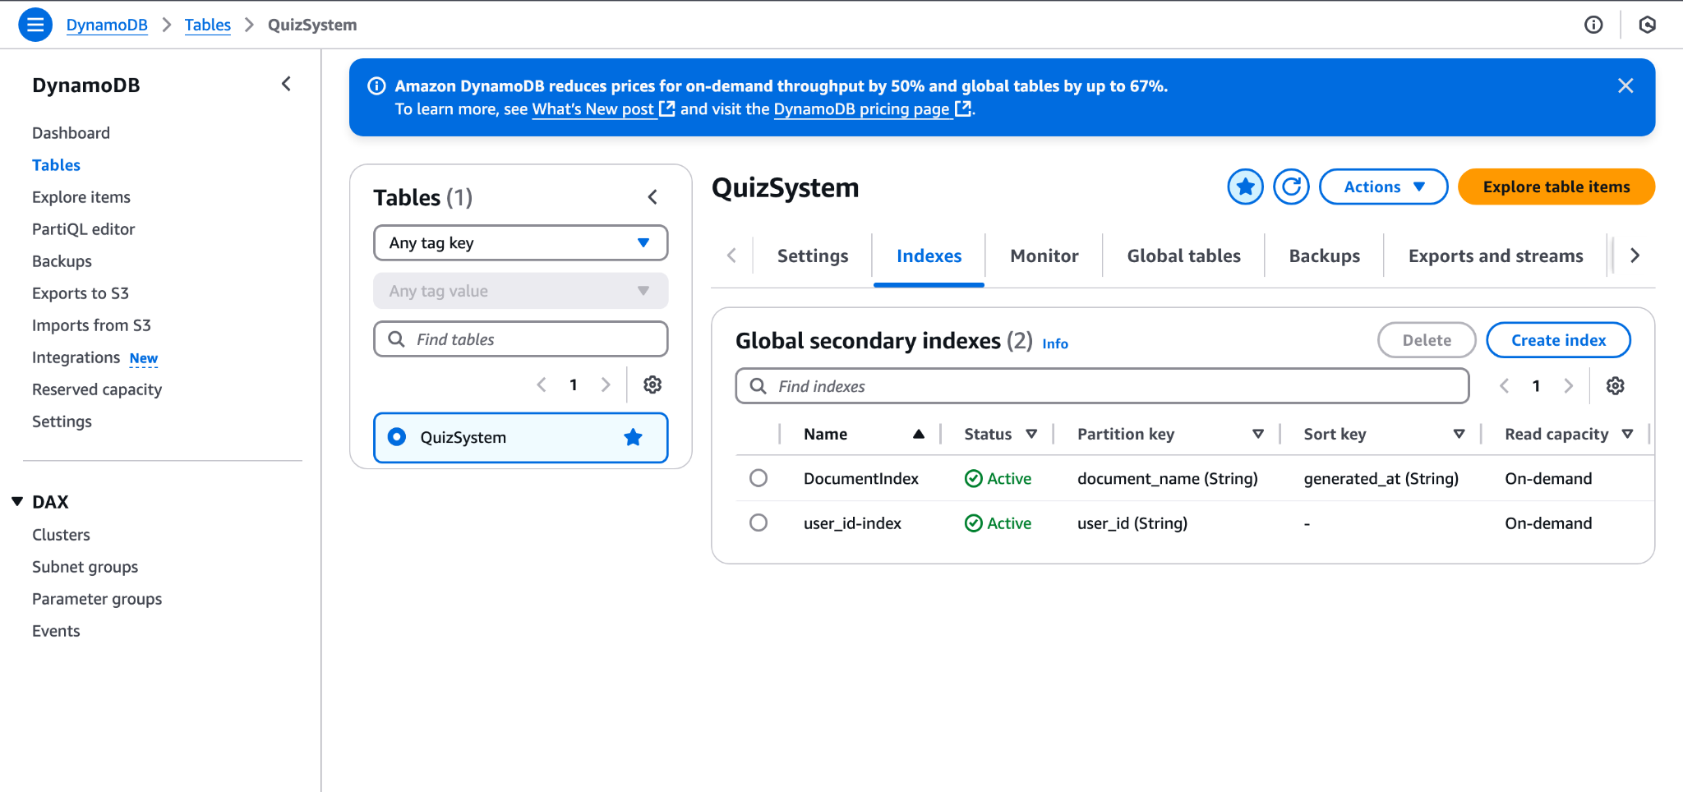
Database Setup
Attribute Name | Type
quiz_id | String
user_id | String
document_name | String
generated_at | String
quiz_name | String
status | String
questions | List
Why DynamoDB?
Serverless & Fully Managed
Seamless Lambda Integration
Flexible Schema for JSON
Auto Scaling & Pay-Per-Use

Slide 13
AWS Lambda Functions
fetchQuiz: Once a file is uploaded, client performs exponential polling on this function to check if the quiz is available in DynamoDB.
fetchUserQuizzes: For “My Quizzes” feature, this lambda function fetches quizzes generated by the logged-in user via a DynamoDB query.

Slide 14
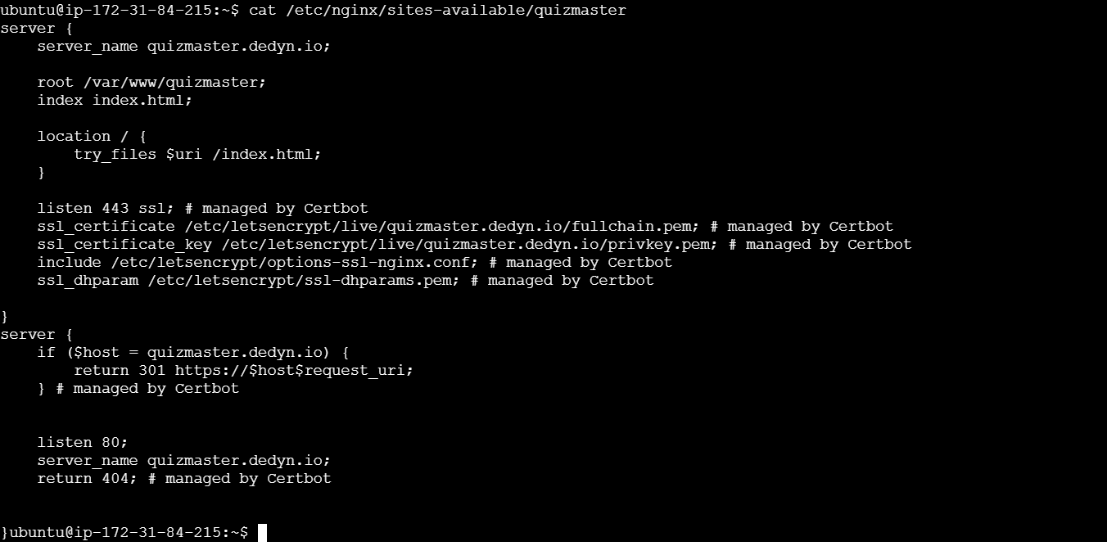
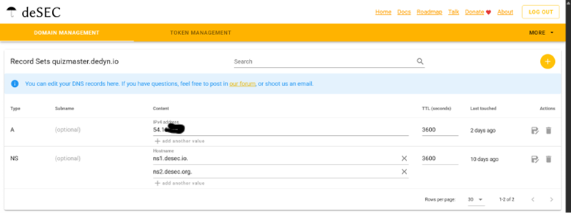
Deployment
Deployed on AWS EC2 (Ubuntu, t2.micro, Free Tier, us-east-1 region)
Nginx used as reverse proxy for routing and SSL verification
SSL: Secured with Certbot + OpenSSL for HTTPS access
DNS: quizmaster.dedyn.io from desec.io, pointed via A record to EC2 public IP
Vite app built with npm run build; deployed to /var/www/quizmaster

Slide 15
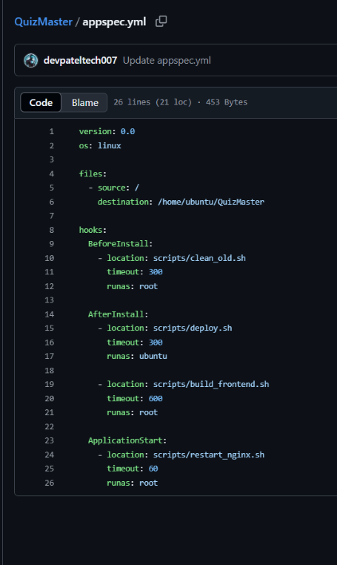
CI/CD Pipeline
CI/CD Tool: AWS CodePipeline connected to GitHub (via webhook authorization)
Deployment Tool: AWS CodeDeploy using appspec.yml for defining deployment stages
EC2 Setup: CodeDeploy Agent installed on EC2 to execute deployment commands
Deployment Scripts:
Located in /scripts directory
Handle cleanup, code pull, dependency install (npm install), build (npm run build), and Nginx restart
Deployment Flow:
Developer pushes commit to GitHub
CodePipeline is triggered
CodeDeploy pulls changes and deploys to EC2
Application updated without downtime (serves old frontend until deployment completes)

Slide 16

Thank you!
Let’s head to the demo…
Live Demo: quizmaster.dedyn.io
GitHub: github.com/ParthPatel00/QuizMaster

